Slide 1
In the field of Artificial Intelligence (AI), there is a large number of nature-inspired techniques to solve a wide range of problems.
Evolutionary computation is a family of algorithms for global optimization inspired by biological evolution.
Based on the behavior of certain biological species, some evolutionary algorithms are developed. In technical terms, they are a family of population-based trial and error problem solvers with a metaheuristic or stochastic optimization character.
In evolutionary computation, an initial set of candidate solutions is generated and iteratively updated. Each new generation is produced by stochastically removing less desired solutions and introducing small random change.
The motive of this study is to design a model which can detect diabetes in patients with maximum accuracy.
The evaluation of model is carried with the help of Pima Indians Diabetes Database (PIDD).
This work implants the usage of nature inspired optimization technique for predicting diabetes. The nature inspired algorithms such as bat algorithm, hybrid bat algorithm, grey wolf optimization algorithm and firefly algorithm were mostly used for numerical data and also used for improving the accuracy and other performance metrics.
Seven classification algorithms were used in detection of diabetes by tuning the hyper parameter.
In this work the majority classifiers performance was enhanced with the help of nature inspired algorithm and produces best results in their performance metrics when compared with base model and randomized search cv.
Firefly algorithm and hybrid bat algorithm outperforms with the highest accuracy of 77.2% in the case of random forest classifier.
ABSTRACT

Slide 2

SCOPE / MOTIVATION
At present, machine learning technology is widely used in many health care applications.
The main problem - Selection a proper machine learning model which gives better results in predicting/detecting.
In real time analyzing a huge amount of data is a mountain task – Machine learning technique is the suitable solution.
It is more flexible, easily configurable, easy to understand and implement.
In those situation machine learning environment provides the best results.
The main moto is to detect whether the patient is diabetic or non diabetic.
The detecting is done by using optimization techniques like randomized search cv and nature inspired algorithms and also used to enhance the classifiers performance.
These features pave a way as a motivation to carry out the project.

Slide 3
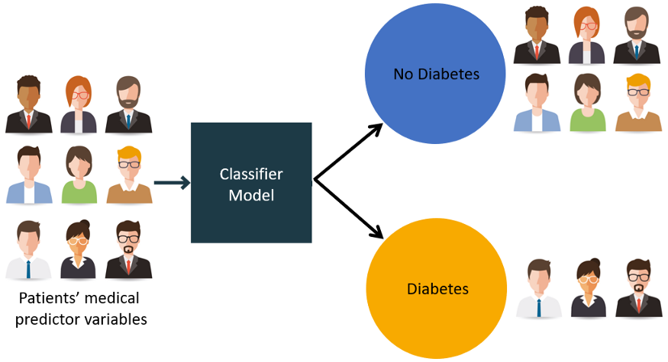
OBJECTIVE
The main objective of this study is to develop a machine learning (ML)-based system for detecting diabetic patients
To classify the abnormalities in medical data using a machine learning algorithm.
To design a model by using nature inspired techniques to enhance the performance of classifiers in detecting abnormalities in medical data.
Comparison of different classifiers performance by using different techniques.
This is a binary (2-class) classification project with supervised learning.

Slide 4

INTRODUCTION
Diabetes is a very familiar word in the present world and crucial challenges in both developed and developing countries .
The number of diabetic patients is increased day by day as a result deaths are also increased day by day.
The insulin hormone in the body produced by the pancreas allows glucose to pass from the food into the bloodstream.
The analysis of diabetes data is a challenging issue because most of the medical data are nonlinear, nonnormal, correlation structured, and complex in nature.
The best approach for the detecting diabetes by machine learning.
ML system has advantage that can use both feature selection and classifiers.
ML also helps in providing the best results in detecting the diabetes.
There are lot of approaches in ML for detecting the diabetes mostly supervised classifiers.
The supervised classifiers like random forest, decision tree, logistic regression, naive bayes and svm.
There are many techniques in ML for finding best performance metrics for the model.
In this study randomized search cv and bat algorithm, hybrid bat algorithm, grey wolf optimization algorithm and firefly algorithm are used.
The best classifier is finalized with the help of performance metrics like accuracy, precision, log loss etc, the classifier which has highest values in performance metrics is treated as a best model.
In this study, the following works are carried out :
Enhancing the classifiers performance by using nature inspired algorithms
To choose the best model out of all proposed models.
Finding the best nature inspired algorithm.

Slide 5
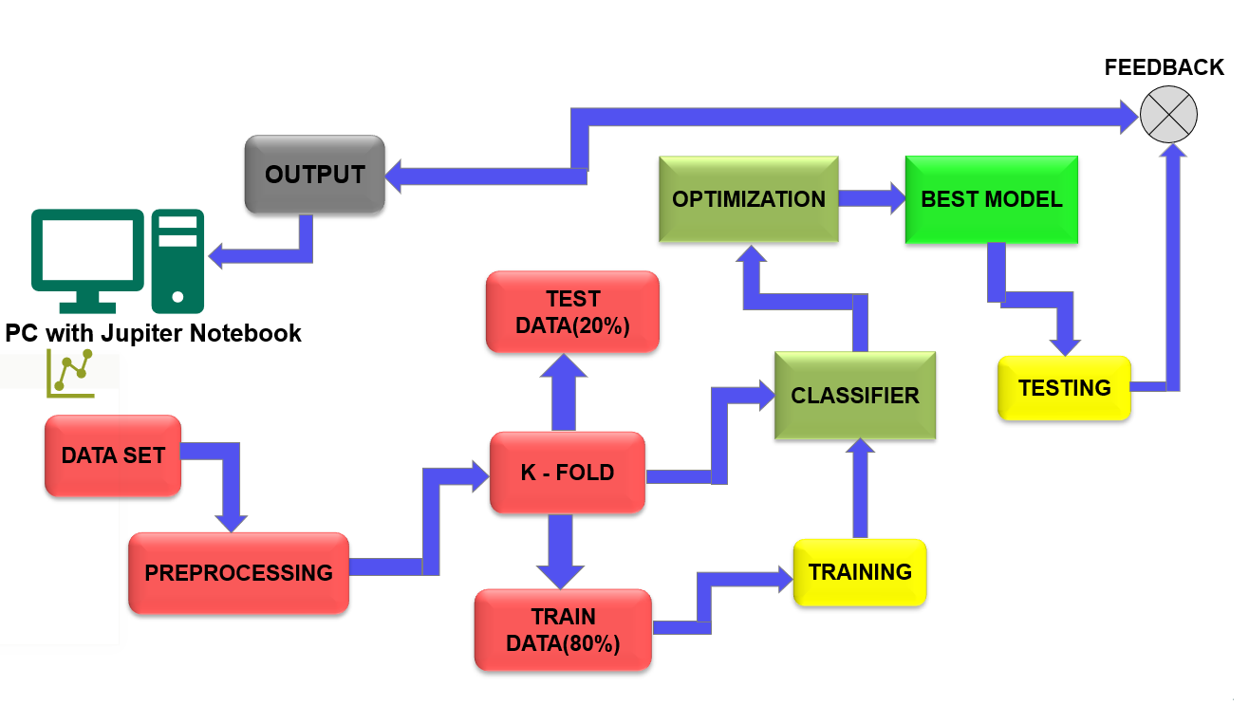
BLOCK DIAGRAM

Slide 6
METHODLOGY
The machine learning model is used to detect whether the person is diabetic or non-diabetic.
Import relevant libraries to test and train our data set and required install some packages related to nature inspired algorithms.
Split the data as training data set and testing dataset they should be in the ratio 80:20 respectively and perform the Model Selection.
Eight different classifiers namely Logistic Regression, K Nearest Neighbour, Decision Tree Classifier, Random Forest Classifier, Extra Tress Classifier, Gaussian NB, Support Vector Classification (SVC) and Linear SVC are considered.
The optimization techniques like random search cv, bat algorithm, hybrid bat, grey wolf optimization and firefly were implemented for different classifiers to enhance the classifiers performance
Different performance metrics like Accuracy Score, Precision Score, Recall Score, F1 Score, Log Loss and roauc are used for evaluating the model.
Based on different performance metrics values the classifier with highest value is considered as the best model.

Slide 7
MODEL EVALUATION
Here, we have chosen 6 evaluation techniques for 8 different classifiers for evaluating our model by using 8 different performance metrics.
EVALUATION TECHNIQUES | CLASSIFIERS | PERFORMANCE METRICS
Base Model | Random Forest | Accuracy
Randomized Search CV | Extra Tree | Precision
Bat Algorithm | Logistic Regression | Recall
Hybrid Bat Algorithm | KNN | F1-Score
Grey Wolf Optimization | LinearSVC | Rocauc
Firefly Algorithm | Gaussian NB | Log Loss
 | SVC | Confusion Matrix
 | Decision Tree | Time Taken (sec)
In the base model for evaluating different classifiers, the parameters were taken as default values.
For randomized search cv and nature-inspired algorithms the default parameters have been changed to improve the performance of the classifier

Slide 8

NATURE INSPIRIED ALGORITHM
Nature inspired algorithms are a bunch of novel problem-solving methodologies and approaches got from natural processes.
Nature Inspired algorithms are profoundly efficient in discovering improved answers for multi-dimensional and multi-modular issues.
The traditional improvement approach in math tracking down the principal the first order derivative of the objective function and equating it to zero to get the critical points. These basic focuses then give the greatest or least worth according to the objective function.

Slide 9

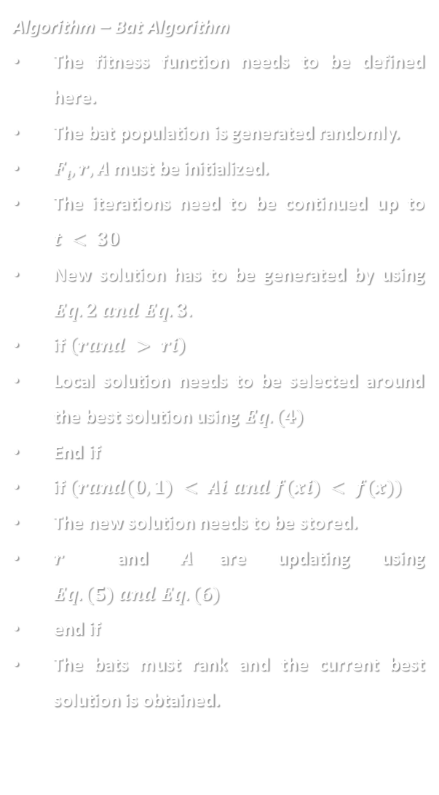
a. Bat Algorithm
Algorithm – Bat Algorithm
The fitness function needs to be defined here.
The bat population is generated randomly.
$Fi, r, A$ must be initialized.
The iterations need to be continued up to $t < 30$
New solution has to be generated by using $Eq. 2 and Eq. 3.$
if $\left(rand > ri\right)$
Local solution needs to be selected around the best solution using $Eq. (4)$
End if
if $(rand(0,1) < Ai and f(xi) < f(x))$
The new solution needs to be stored.
$r$ and $A$are updating using $Eq. (5) and Eq. (6)$
end if
The bats must rank and the current best solution is obtained.
The basic Bat algorithm is bio-inspired on the bio-sonar or echo location characteristics of bats. ​
In nature, bats release ultrasonic waves to the environment around it for the purposes of hunting or navigation. ​
After the emission of these waves, it receives the echoes of the waves, and based on the received echo they locate themselves and identify obstacles in their ways and preys. ​

Slide 10

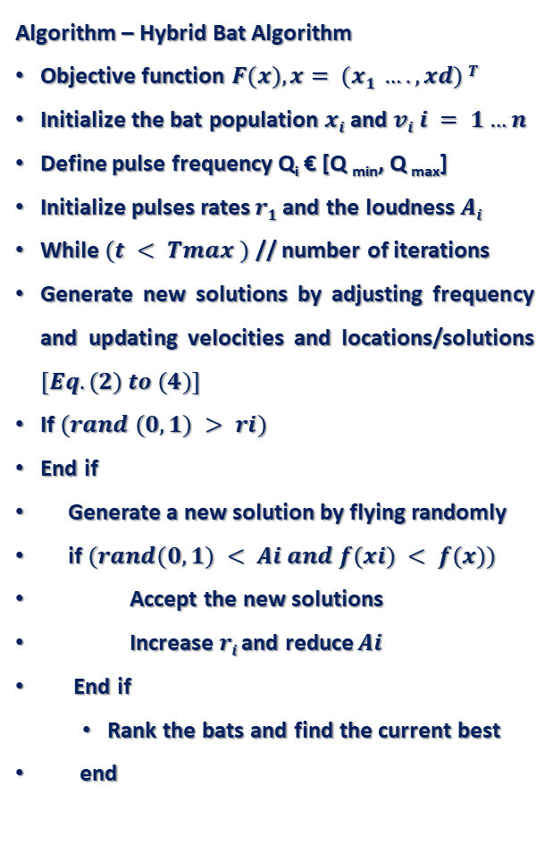
b. Hybrid Bat Algorithm
Algorithm – Hybrid Bat Algorithm
Objective function $F(x), x= (x1 …., xd) T$
Initialize the bat population $xi$ and $vi i = 1…n$
Define pulse frequency Q_{i} € [Q _{min}, Q _{max}]
Initialize pulses rates $r1$and the loudness $Ai$
While $(t < Tmax )$ // number of iterations
Generate new solutions by adjusting frequency and updating velocities and locations/solutions $[Eq. (2) to (4)]$
If $(rand (0,1) > ri)$
End if
Generate a new solution by flying randomly
if$(rand(0,1) < Ai and f(xi) < f(x))$
Accept the new solutions
Increase $ri$and reduce $Ai$
End if
Rank the bats and find the current best
end
Hybrid Bat Algorithm was obtained by hybridizing the original BA using the Differential Evolution (DE) strategies.
DE optimizes a problem by maintaining a population of candidate solutions and creates new candidate solutions by combining the existing ones according to its simple formulae, and then keeping whichever candidate solution has the best score or fitness on the optimization problem at hand. DE supports a differential mutation, a differential crossover and a differential selection.

Slide 11

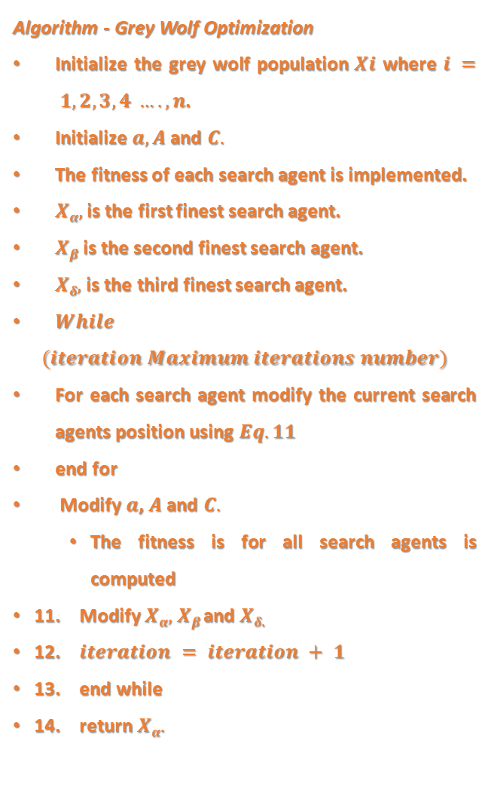
c. Grey Wolf Optimization Algorithm
Algorithm - Grey Wolf Optimization
Initialize the grey wolf population$Xi$ where $i = 1,2,3,4 …., n$.
Initialize $a, A$ and $C.$
The fitness of each search agent is implemented.
$Xα,$ is the first finest search agent.
$Xβ$is the second finest search agent.
$Xδ,$ is the third finest search agent.
$While$
$$(iteration Maximum iterations number)$$
For each search agent modify the current search agents position using $Eq. 11$
end for
Modify $a$, $A$and $C.$
The fitness is for all search agents is computed
11. Modify $Xα,$ $Xβ$ and $Xδ$.
12. $iteration = iteration + 1$
13. end while
14. return $Xα.$
The GWO algorithm mimics the leadership hierarchy and hunting mechanism of gray wolves in nature.
Four types of grey wolves such as alpha, beta, delta, and omega are employed for simulating the leadership hierarchy.
In addition, three main steps of hunting, searching for prey, encircling prey, and attacking prey, are implemented to perform optimization.

Slide 12

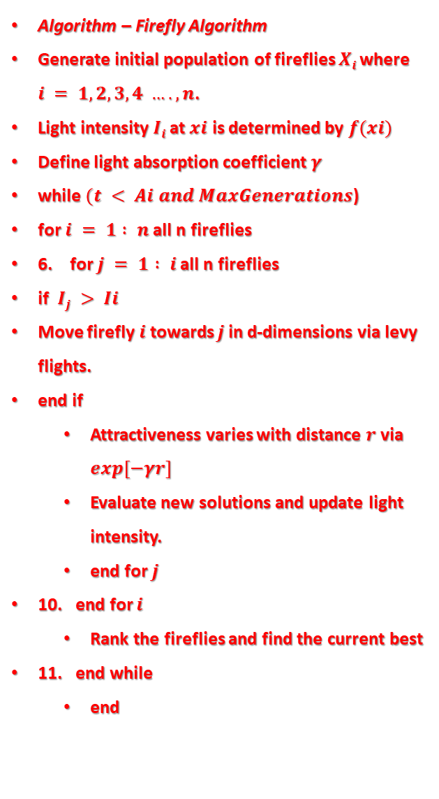
d. Firefly Algorithm
Algorithm – Firefly Algorithm
Generate initial population of fireflies $Xi$ where $i = 1,2,3,4 …., n$.
Light intensity $Ii$at$xi$ is determined by $f(xi)$
Define light absorption coefficient$γ$
while $(t < Ai and MaxGenerations$)
for $i = 1 : n$ all n fireflies
6. for $j = 1 : i$ all n fireflies
if $Ij > Ii$
Move firefly$i$towards $j$ in d-dimensions via levy flights.
end if
Attractiveness varies with distance $r$via $exp[−γr]$
Evaluate new solutions and update light intensity.
end for $j$
10. end for $i$
Rank the fireflies and find the current best
11. end while
end
Among swarm-intelligence-based algorithms, firefly algorithm (FA) is now one of the most widely used. Firefly algorithm was developed by Xin-She Yang in 2008,
based on inspiration from the natural behavior of tropical fireflies.
FA tries to mimic the flashing pattern and attraction behavior of fireflies.
The purpose of these flashing lights is two-fold: to attract mating partners and to warn potential predators.
Obviously, this flashing light and its intensity can obey some rules, including physical laws.
The attractiveness is proportional to the brightness and they both decrease as their distance increases for any two flashing fireflies, the less bright one will move towards the brighter one.
If there is no brighter one than a particular firefly, it will move randomly.

Slide 13
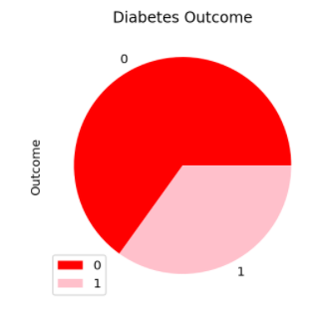
DATA SET EXPLORATION
The data set which is used for this study is PIMA dataset
The data set consists of 768 observations with 8 medical predictor features.
The target feature is the outcome when the outcome is 1 the person is diabetic and with 0 the person is non-diabetic
The 8 medical predictor features are:
Pregnancies : Number of times pregnant
Glucose : Plasma glucose concentration a 2 hours in an oral glucose tolerance test
Blood Pressure : Diastolic blood pressure (mm Hg)
Skin Thickness : Triceps skin fold thickness (mm)
Insulin : 2-Hour serum insulin (mu U/ml)
BMI : Body mass index (weight in kg/(height in m)²)
Diabetes Pedigree Function : Diabetes pedigree function
Age : Age (years)
Outcomes : Zeroes and Ones
65%
35%

Slide 14
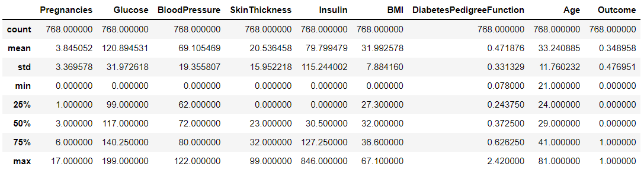
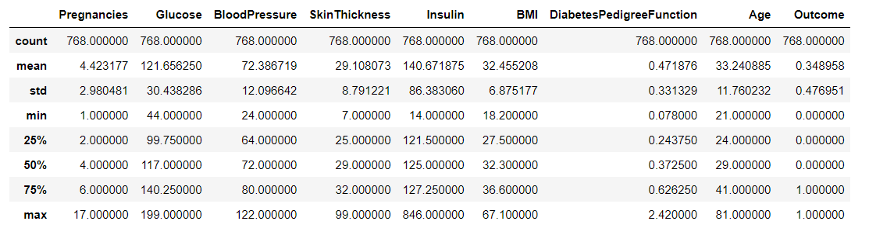
Statistical data before replacing with zeros
Statistical data after replacing zeros with median

Slide 15
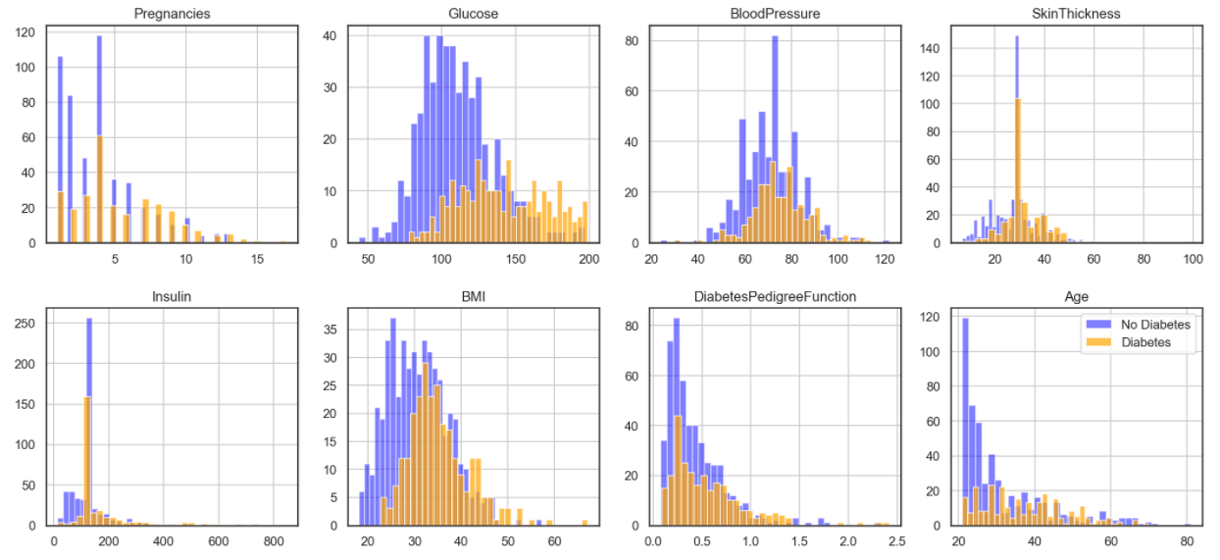
Plot of each feature compared with outcome after replacing by zeros

Slide 16
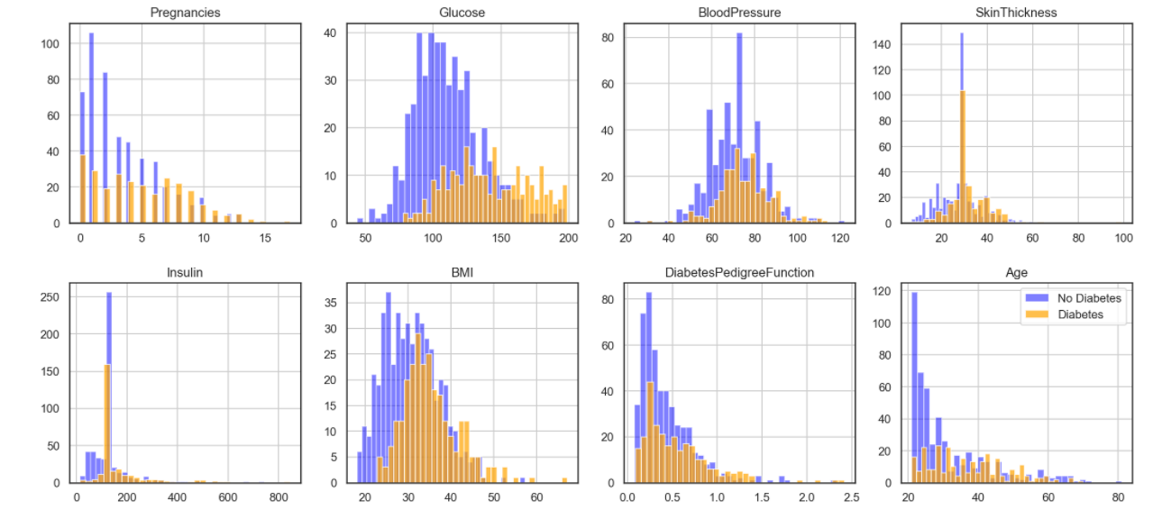
Plot of each feature compared with outcome before replacing by zeros

Slide 17
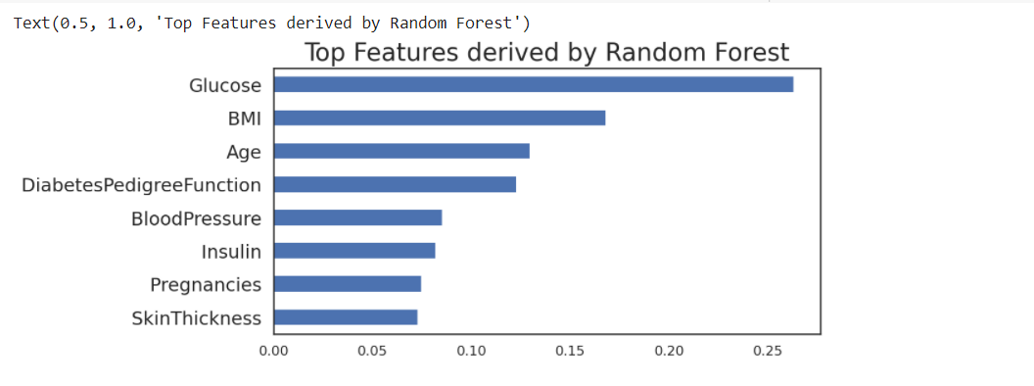
Top features in the data set
Out of all eight medical predictors, Glucose and BMI play a key role in detecting diabetes. That means the model’s accuracy majorly depends on Glucose and BMI.

Slide 18

SOFTWARE USED
Jupyter Notebook

Slide 19
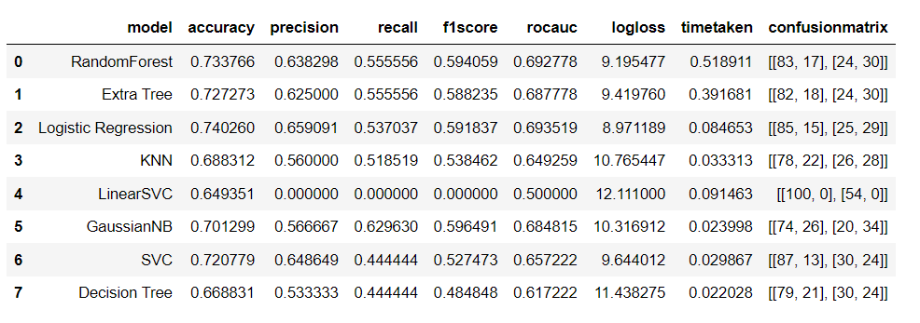
FOR BASE LINE MODEL THE PERFORMANCE METRICS:
In base line model normal calculation of performance metrics takes place.
In base line model logistic regression give best accuracy around 74.0 %.
MODEL EVALUATION RESULTS

Slide 20
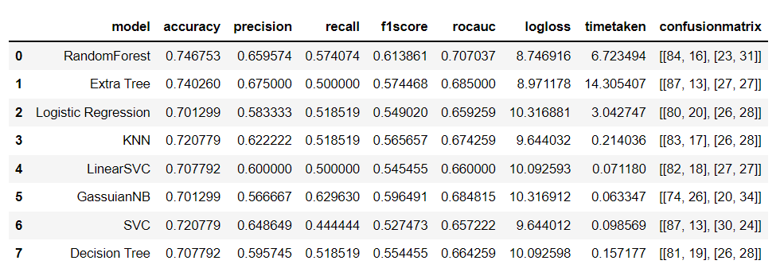
FOR RANDOMIZED SEARCH CV THE PERFORMANCE METRICS:
In base line model normal calculation of performance metrics takes place.
In base line model random forest give best accuracy around 74.6%.

Slide 21
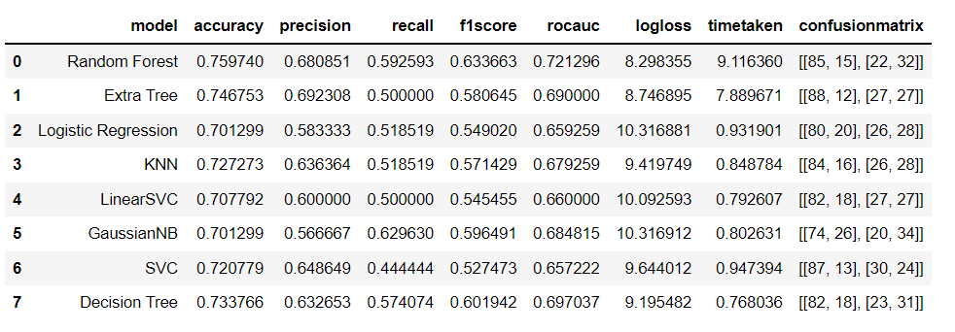
FOR BAT ALGORITHM MODEL THE PERFORMANCE METRICS:
In base line model normal calculation of performance metrics takes place.
In base line model random forest give best accuracy around 75.9%.

Slide 22
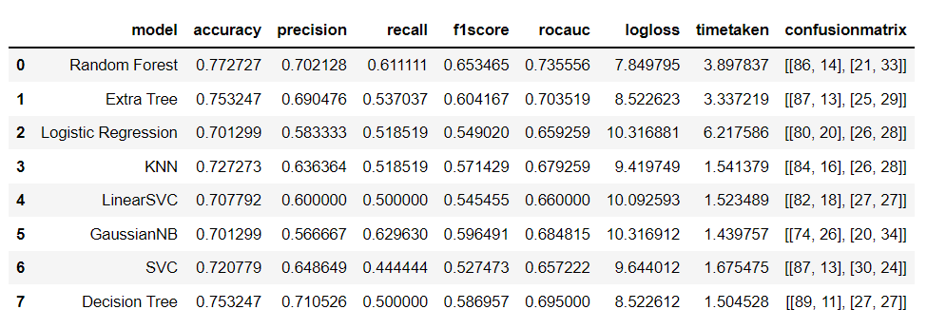
FOR HYBRID BAT MODEL THE PERFORMANCE METRICS:
In base line model normal calculation of performance metrics takes place.
In base line model random forest give best accuracy around 77.2%.

Slide 23
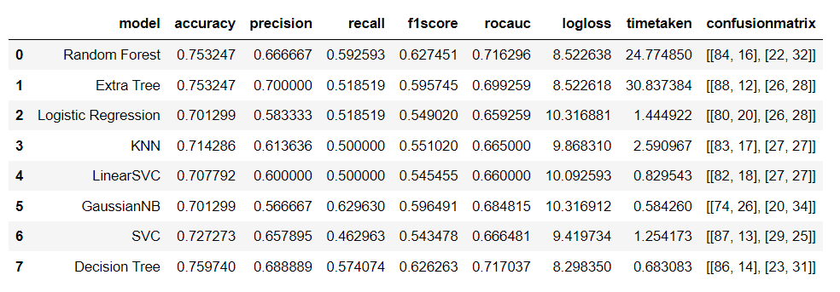
FOR GREY WOLF OPTIMIZATION MODEL, THE PERFORMANCE METRICS:
In base line model normal calculation of performance metrics takes place.
In base line model decision tree give best accuracy around 75.9%.

Slide 24
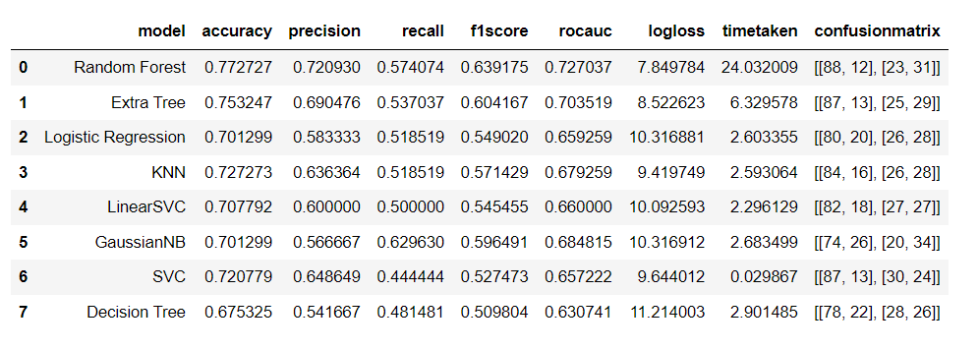
FOR FIREFLY MODEL THE PERFORMANCE METRICS:
In base line model normal calculation of performance metrics takes place.
In base line model random forest give best accuracy around 77.2%.

Slide 25
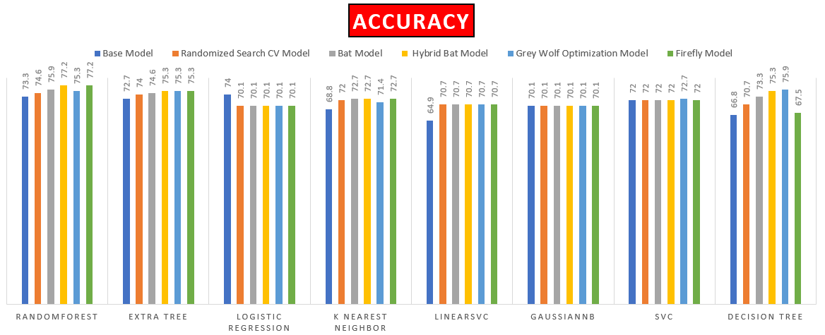
COMPARISION OF EACH TECHNIQUE BASED ON PERFORMANCE METRICS
Highest accuracy is obtained in Hybrid bat model and firefly by using random forest classifier with accuracy of 77.2%

Slide 26
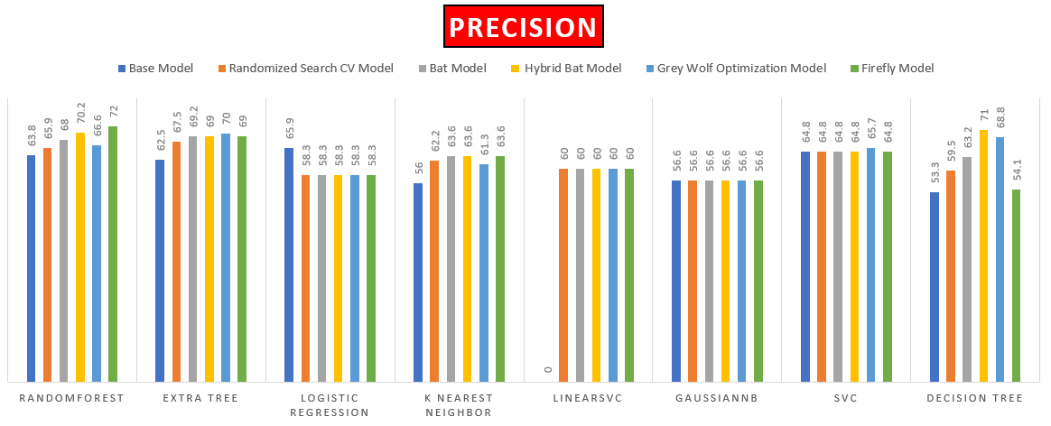
Highest precision is obtained in firefly model by using random forest classifier with precision of 72%

Slide 27
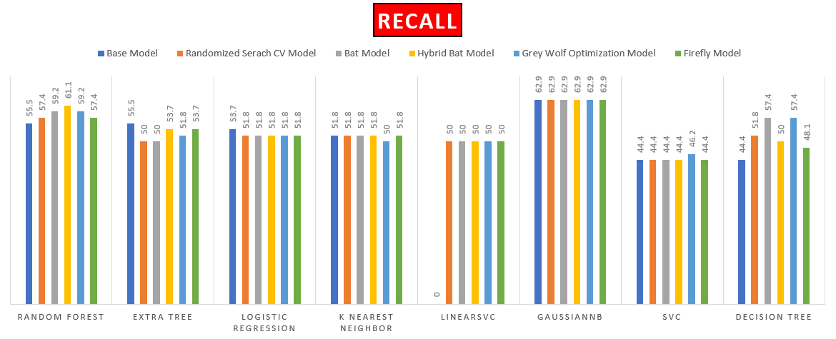
Highest recall is obtained in all the models by with all classifier with recall of 62.9%

Slide 28
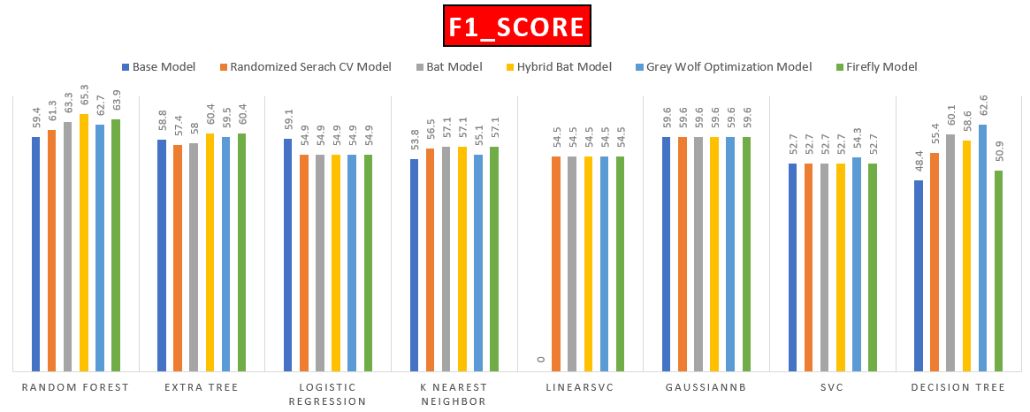
Highest F1 score is obtained in hybrid bat model by using random forest classifier with F1 score of 65.3%

Slide 29
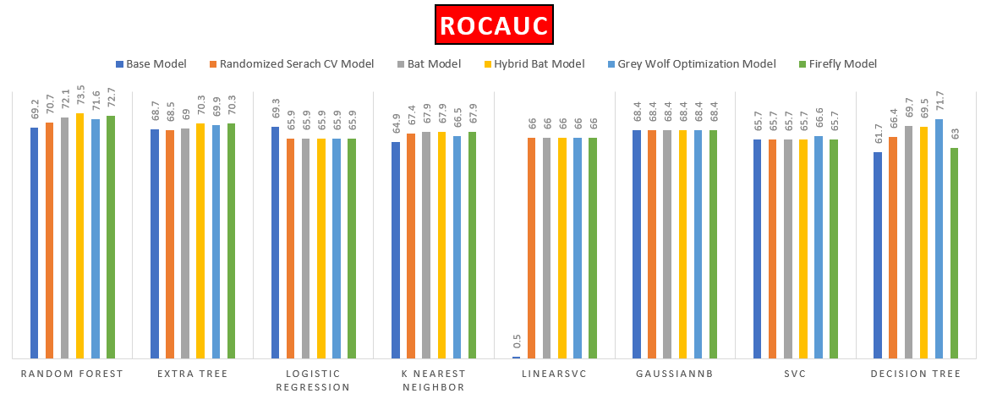
Highest rocauc is obtained in hybrid bat model by using random forest classifier with rocauc of 73.5%

Slide 30
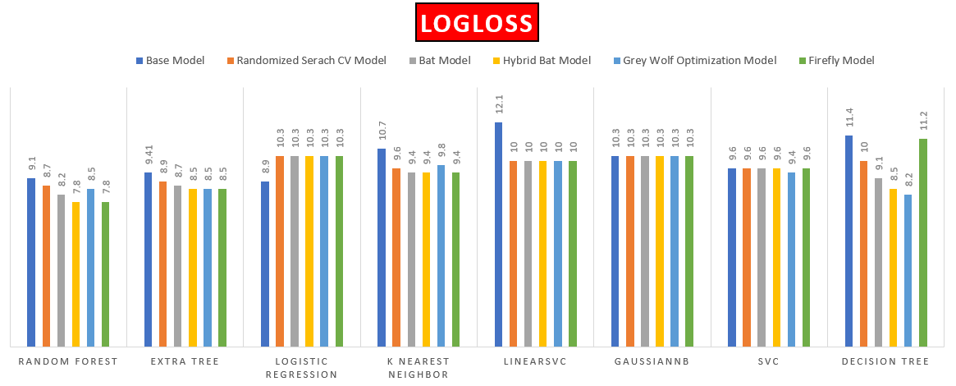
Highest log loss is obtained in grey wolf optimization model by using linear svc classifier with log loss of 12.5%

Slide 31
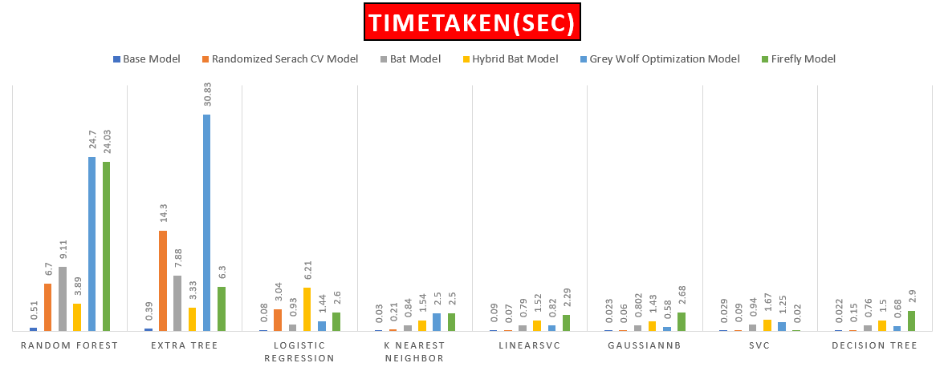
More time is taken by firefly model while using extra tree classifier with time of 30.8 seconds

Slide 32
REFERENCES
Arkadip Ray, Avijit Kumar Chaudhuri “Smart healthcare disease diagnosis and patient management: Innovation, improvement and skill development” Machine Learning with Applications, Volume 3, March 2021.
Alehegn, Minyechil, Rahul Joshi, and Preeti Mulay, “Analysis and prediction of diabetes mellitus using machine learning algorithm”, International Journal of Pure and Applied Mathematics 118, July 2018.
Md. Maniruzzaman, Md. Jahanur Rahman, Benojir Ahammed and Md. Menhazul Abedin “Classification and prediction of diabetes disease using machine learning paradigm”, Health Information Science and Systems, January 2020.
Mercaldo Francesco, Vittoria Nardone, and Antonella Santone “Diabetes mellitus affected patients’ classification and diagnosis through machine learning techniques”, Procedia Computer Science, September 2017.
Kashif Naseer Qureshi, Sadia Din, Gwanggil Jeon, Francesco Piccialli “An Accurate and Dynamic Predictive Model for a Smart M-Health System Using Machine Learning”, Computers and Electrical Engineering, Volume 95, October 2021.
Deepti Sisodia, Dilip Singh Sisodia Prediction of Diabetes using Classification Algorithms”, Procedia Computer Science, International Conference on Computational Intelligence and Data Science (ICCIDS), May 2018.
S. R. Jino Ramson, K. Lova Raju, S. Vishnu and Theodoros Anagnostopoulos” Nature Inspired Optimization Techniques for Image Processing A Short Review”, Springer International Publishing AG, Intelligent Systems Reference Library, Volume 150, January 2019.

Slide 33
THANK YOU

